Slide 1
Linear Equations in Linear Algebra
1.8 The Matrix of a Linear Transformation
Bumhee Cho

Slide 2
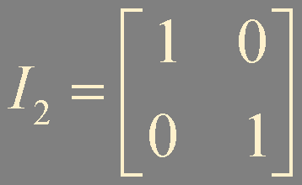
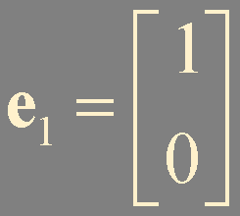
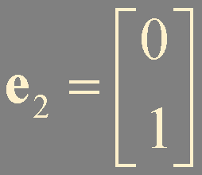
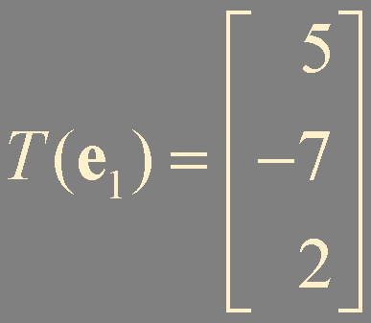
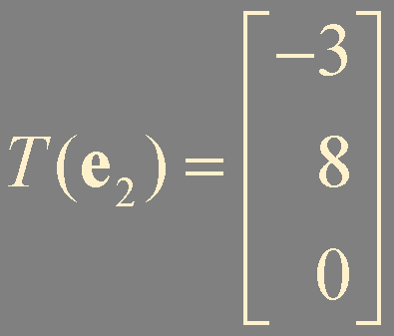
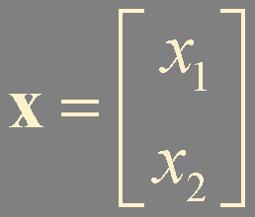
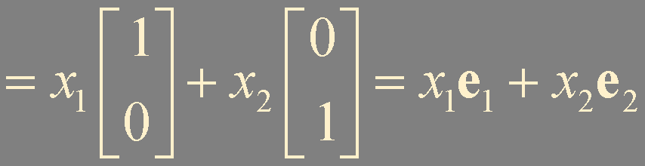
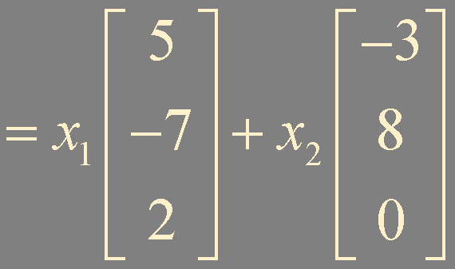
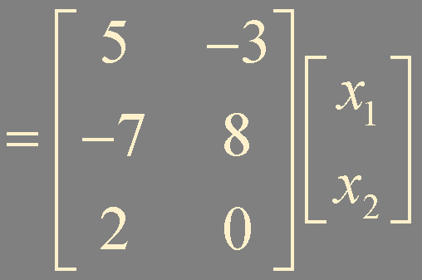

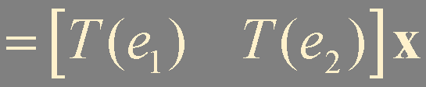
Example 1. How to determine a matrix transformation

Slide 3



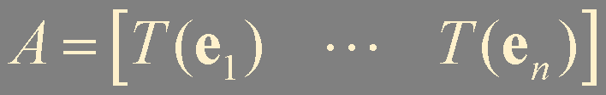
Theorem 10.
Let T : ℝ^{n} → ℝ^{m} be a linear transformation. Then there exists a unique matrix A such that
In fact, A is the m × n matrix whose j-th column is the vector , where is the j-th column of the identity matrix in ℝ^{n}:
standard matrix for the linear transformation T

Slide 4

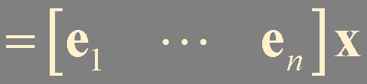



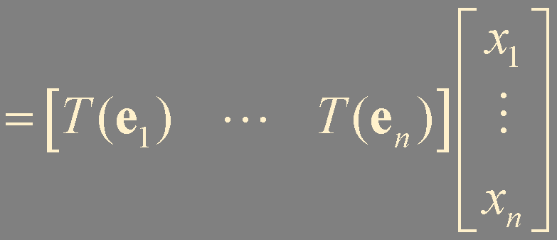
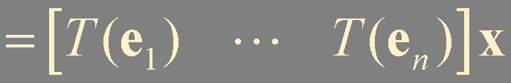


Slide 5


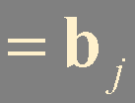
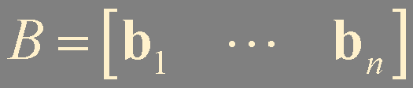
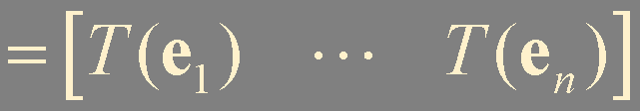

Slide 6



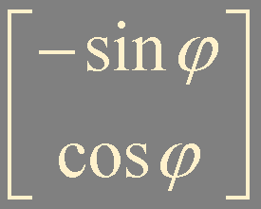
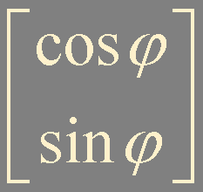

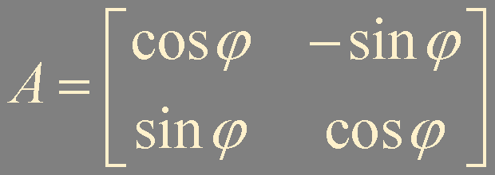
Example 2.

Slide 7
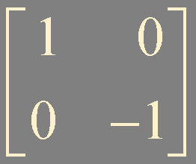
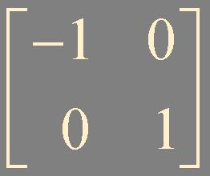







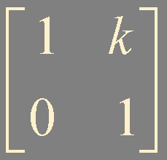



Geometric Linear Transformation of ℝ²

Slide 8

Onto
A mapping T : ℝ^{n} → ℝ^{m} is said to be onto ℝ^{m} if each b in ℝ^{m} is the image of at least one x in ℝ^{n}
Does T(x) = b have at least one solution for each b in ℝ^{m} ?
Does T map ℝ^{n} onto ℝ^{m} ?
range
range
ℝ^{m}
ℝ^{n}
ℝ^{m}
ℝ^{n}
T is not onto ℝ^{m}
T is onto ℝ^{m}

Slide 9
One-to-one
A mapping T : ℝ^{n} → ℝ^{m} is said to be one-to-one if each b in ℝ^{m} is the image of at most one x in ℝ^{n}
Does T(x) = b have either a unique solution or none at all?
Is T one-to-one ?
range
range
ℝ^{n}
ℝ^{m}
ℝ^{n}
ℝ^{m}
T is not one-to-one
T is one-to-one

Slide 10
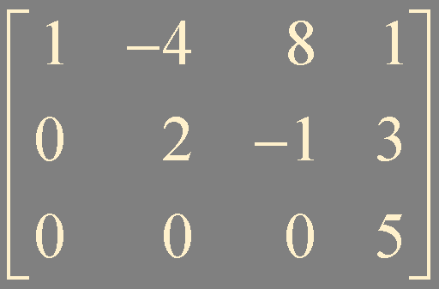
Example 2. Does the following T map ℝ⁴ onto ℝ³? Is T a one-to-one mapping?
ℝ⁴ onto ℝ³
not one-to-one

Slide 11
Theorem 11.
Let T : ℝ^{n} → ℝ^{m} be a linear transformation.
Then T is one-to-one if and only if the equation T(x) = 0 has only trivial solution.
T(0) = T(00) = 0T(0) = 0
T(u) = b
T(v) = b
T(u - v) = T(u) - T(v) = 0
u - v ≠ 0
T(x) = 0 has more than one solution

Slide 12

Theorem 12.
Let T : ℝ^{n} → ℝ^{m} be a linear transformation and let A be the standard matrix for T. Then:
T maps ℝ^{n} onto ℝ^{m} if and only if the columns of A span ℝ^{m}
T is one-to-one if and only if the columns of A are linearly independent
Theorem 4.
The followings are all true or all false;

Slide 13

Example 3. Does the following T map ℝ² onto ℝ³? Is T a one-to-one mapping?
linearly independent
one-to-one
two pivot positions
not ℝ² onto ℝ³

Slide 14
Summary
standard matrix
onto
one-to-one

